Slide 1

Chapter 2
Foundations: Emotion, Motivation, and the Nature of Well-Being

Slide 2
The Basic Emotions
Ekman Seven basic emotions
Sadness, fear, anger, disgust, contempt, surprise, happiness
Positive and negative emotions--relatively independent
Core affect
Similar to personality trait: our emotional reactions consistently experienced; can impact how we evaluate/interpret situations we find ourselves in
Combination of biological, cognitive, behavioral, and sociocultural influences
Notes:
Seven basic emotions: Sadness, fear, anger, disgust, contempt, surprise, and happiness.
Core affect: It comprises our unique blend of the pleasant/unpleasant and the activated/deactivated dimensions that we carry with us at almost an unconscious level.

Slide 3
The Components of Emotions
The Biology of Emotions: The Happy Brain
Left prefrontal cortex--associated with happiness
Addiction is partly associated with the prefrontal cortex
Pleasure hot spots
Notes:
Left prefrontal cortex--associated with happiness: This portion has greater ability to recover from negative emotions, as well as enhanced ability to suppress negative emotions.
Pleasure hot spots: Regions of the brain associated with pleasure.

Slide 4
The Components of Emotions
The Biology of Emotions: Neurotransmitters and the Chemicals of Pleasure
Chemical in brain responsible for pleasurable experience
The effects of the hormone oxytocin
Tetrahydrocannabinols or THC
Bliss molecule
Notes:
Tetrahydrocannabinols (THC): Produced by brain, active ingredient in marijuana.
Bliss molecule: Neurotransmitter anandamide, produces a calming effect upon binding with cannabinoid receptors.

Slide 5
The Components of Emotions
The Biology of Emotions: Neuroplasticity
Growth of a brain
Gray matter may slightly increase in size upon learning music and meditation

Slide 6
The Components of Emotions
The Biology of Emotions: The Genetics of Emotions
Genetic influence--30–50% (twin research)
Positive Affect: 40% of variability due to genetics
Negative Affect: 55% of variability due to genetics
Family environment and learning can impact well-being
Notes:
Genetic influence--30–50%: In case of twins, 40% of the variability among people in positive emotionality, 55% in negative emotionality, and 48% in overall well-being.
Family environment and learning can impact well-being: In shared family environment or learning accounted for only 22% of positive emotionality and an extremely small 2% of negative emotionality.

Slide 7
The Components of Emotions
The Biology of Emotions: The Happiness Set Point
Hereditability--most people have an average level of a set point
Everyone returns to an average or baseline level of well-being
Recent research does not support strong interpretation of set point…life satisfaction can change over time; 26 year longitutional study: we can increase our happiness over time
Notes:
Hereditability--most people have an average level of a set point: Beyond temporary highs and lows.
.
Everyone returns to an average or baseline level of well-being: A level set by genetics.

Slide 8
The Components of Emotions
The Biology of Emotions: Do Genes Rule Emotional Lives?
Authors: we influence our well-being by creating environments that are more conducive to feelings of happiness and by working with our genetic makeup
Basic point…genes affect the mind largely indirectly, by influencing the kinds of experiences we have and the kinds of environments we seek out. Genetic steersman…it’s your life and, within wide limits, you can choose your own destinations instead of having them chosen for you (p.35)

Slide 9
The Components of Emotions
The Biology of Emotions: Do Our Genes Rule Our Emotional Lives?
Affect influences, experiences, and environments sought after
Do not completely determine happiness--typical level of well-being can change with time

Slide 10
The Components of Emotions
The Highly Sensitive Person (HSP)
Differential susceptibility: Genes express themselves differently in different environments.
DOES
D: greater depth of cognitive processing
O: easily overstimulated
E: emotionally reactive and empathic
S: sensitive to subtle stimuli
Notes:
Differential susceptibility: Genes express themselves differently in different environments. DOES describes a greater depth of cognitive processing (D), is easily overstimulated (O), is emotionally reactive and empathic (E), and is sensitive to subtle stimuli (S).

Slide 11
The Components of Emotions
The Highly Sensitive Person (HSP)
20% of population exhibit this trait
Those with HSP trait and raised in difficult homes tend to have emotional problems; those raised in supportive homes have advantages because their sensitivity to the environment and to other people helps them navigate their worlds better
Notes:
Differential susceptibility: Genes express themselves differently in different environments. DOES describes a greater depth of cognitive processing (D), is easily overstimulated (O), is emotionally reactive and empathic (E), and is sensitive to subtle stimuli (S).

Slide 12
The Components of Emotions
Cognition: How We Think Impacts How We Feel
Changing negative styles of thinking changes how we feel
Lonely…I am loved by someone
Crisis…opportunity
Seligman’s learned optimism: Possible to unlearn negative styles and learn how to interpret events with more realistic optimism

Slide 13
The Components of Emotions
Cognition: How We Think Impacts How We Feel
How people think about time can impact:
Well-being
Physical health
Coping with negative events and decision making
Work satisfaction
Notes:
Transcendental-future type tends to focus on how present life will impact life after death.

Slide 14
The Components of Emotions
Cognition: How We Think Impacts How We Feel
Five approaches that influence our happiness
Past-negative type (focus on neg past experiences)
Past-positive type (pleasant, nostalgic view of past events)
Present-hedonistic type (pleasure-seeking impulses)
Present-fatalistic type (feel powerless to change present or future)
Future-oriented type (ambitious but feel nagging sense of urgency that can impact relationships)
Transcendental-future (how present will impact life after death)
Notes:
Transcendental-future type tends to focus on how present life will impact life after death.

Slide 15
The Components of Emotions
Cognition: How We Think Impacts How We Feel
Balanced Time Perspective may be most advantageous for well-being
We should try to learn from the past and maintain the ability to look toward goals
We should try to delay gratification to reach our hoped-for future while giving ourselves time to have fun and enjoy present pleasures
Notes:
Transcendental-future type tends to focus on how present life will impact life after death.

Slide 16
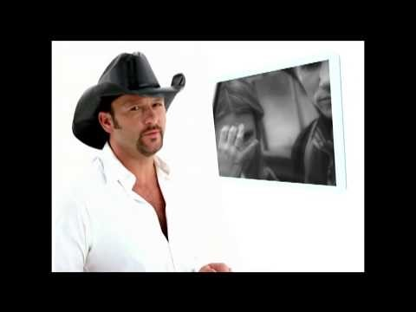
The Components of Emotions
Cognition: How We Think Impacts How We Feel
Live Like You Were Dying Time
“imagining time as scarce prompted people to seize the moment and extract greater well-being from their lives” (Layous, Kurtz, Chancellor, Lyubomirsky, 2017, p. 1)
Notes:
Transcendental-future type tends to focus on how present life will impact life after death.

Slide 17
The Components of Emotions
Behavior: How We Act Influences How We Feel
Behavior causes a major influence on emotions
Contribution of positive psychology is its focus on positive behaviors

Slide 18
The Components of Emotions
How We Act Influences How We Feel :Virtues, Strengths, Character, and Our Emotions
Strengths and virtues important tools to handle stress and difficult situations
The StrengthsFinder evaluates 34 themes
Signature strengths are most important
Notes:
The Strengths Finder evaluates 34 themes: Adaptability, self-assurance, and responsibility classified under four headings: Executing, Influencing, Relationship, and Strategic Thinking.
Signature strengths are most important: Positive traits that a person owns, celebrates, and frequently exercises

Slide 19
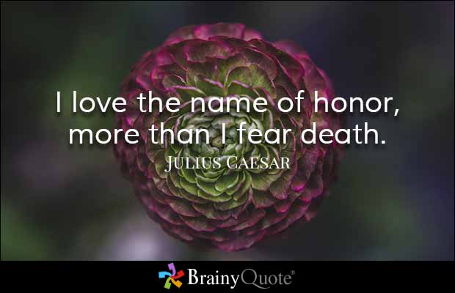

Slide 20
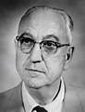
Classifications of Illness and Strengths
Karl Menninger
1893-1990
1919 he and his father founded Menninger Clinic
Provided a “total environment” where people stayed and were treated with kindness in a family atmosphere with medical doctors
Also patients had to exercise!

Slide 21
Classifications of Illness and Strengths
Karl Menninger
Instrumental in founding the Winter Veterans Administration Hospital in Topeka KS (one of the largest psychiatric training centers in the world)
Challenged labeling of pathology
Diagnosis focused on:
- life process vs. states or conditions
Power of hope, faith, & love

Slide 22
Classifications of Illness and Strengths
“Strength” defined as: capacity for feeling, thinking, and behaving in a way that allows optimal functioning in the pursuit of valued outcomes (Linley & Harrington, 2006).
Strengths can be acquired with time, effort and determination (Seligman)

Slide 23

Criteria for Strengths
A strength is a trait
A psychological characteristic seen across different situations and over time (e.g., Kindness)
A strength is valued in its own right
Strengths are ubiquitous (valued in almost every culture in the world)

Slide 24

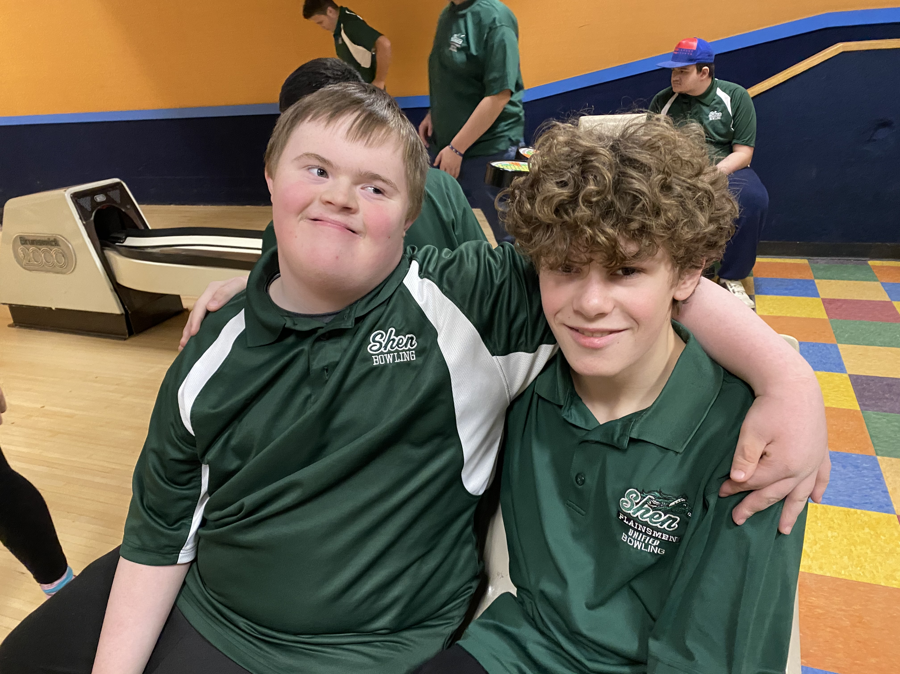
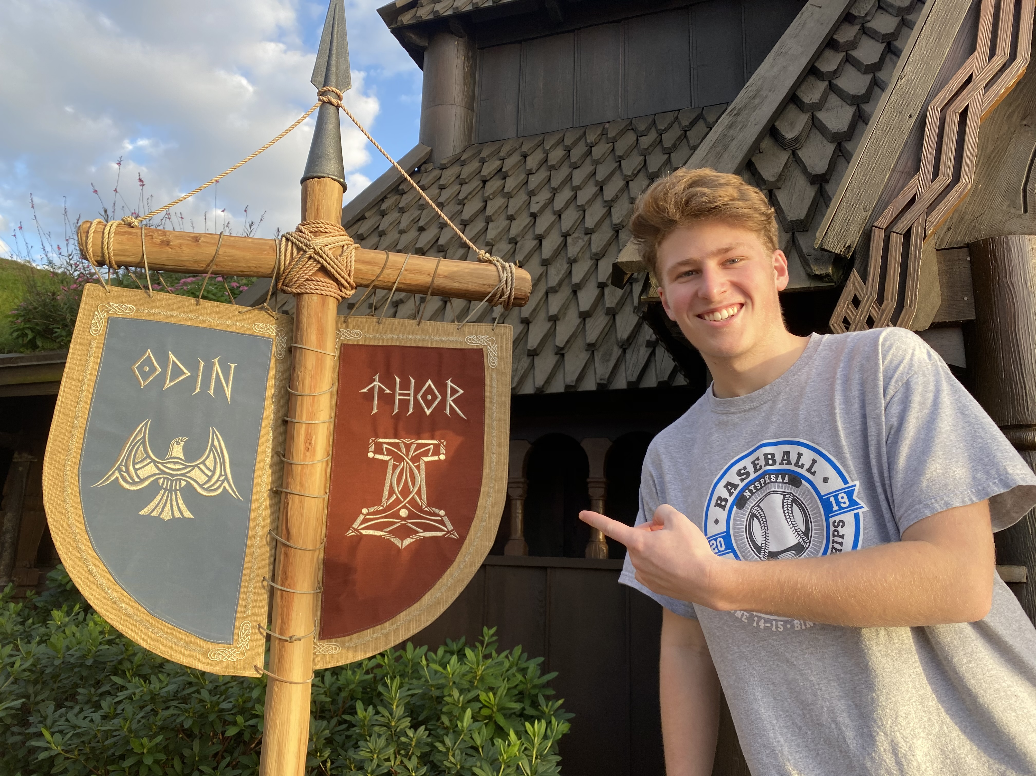
Bravery
Kindness
Perspective

Slide 25
Values in Action Classification of Strengths
Developed by Peterson & Seligman (2004)
Antithesis of the DSM
Provides a common language for strengths
24 Strengths grouped by 6 Virtues
Wisdom and Knowledge (cognitive strengths)
Courage (emotional strengths to accomplish goals)
Humanity (interpersonal strengths)
Justice (civic strengths)
Temperance (strengths that protect against excess)
Transcendence (strengths that forge connections to larger universe and provide meaning)

Slide 26
Values in Action
VIA Character Strengths List

Slide 27
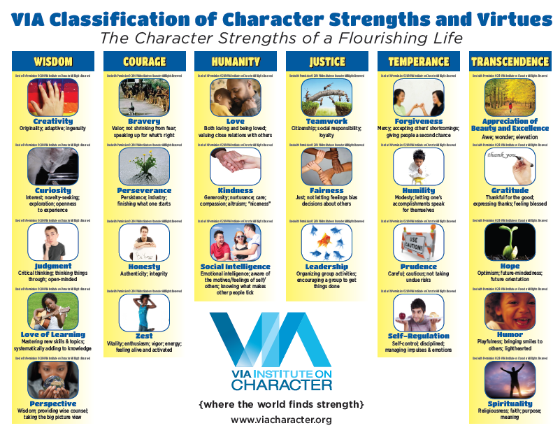

Slide 28
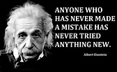
Wisdom and Knowledge
Creativity [originality, ingenuity]: Thinking of novel and productive ways to conceptualize and do things; includes artistic achievement but is not limited to it
Curiosity [interest, novelty-seeking, openness to experience]: Taking an interest in ongoing experience for its own sake; finding subjects and topics fascinating; exploring and discovering; like ambiguity; can be specific curiosity or general
Judgment [critical thinking]:
Thinking things through and examining them from all sides; not
jumping to conclusions; being able to
change one's mind in light of evidence;
weighing all evidence fairly

Slide 29
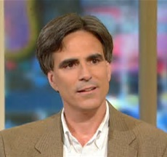
Wisdom and Knowledge
Love of Learning: Mastering new skills, topics, and bodies of knowledge, whether on one's own or formally; obviously related to the strength of curiosity but goes beyond it to describe the tendency to add systematically to what one knows
Perspective [wisdom]: Being able to
provide wise counsel to others;
having ways of looking at the
world that make sense to oneself
and to other people

Slide 30
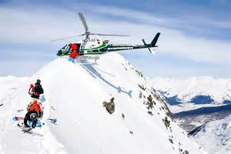
Courage
Life begins when you leave your comfort zone
Bravery [valor]: Not shrinking from threat, challenge, difficulty, or pain; speaking up for what is right even if there is opposition; acting on convictions even if unpopular; includes physical bravery but is not limited to it
Perseverance [persistence, industriousness]: Finishing what one starts; persisting in a course of action in spite of obstacles; “getting it out the door”; taking pleasure in completing tasks

Slide 31

Courage
Honesty [authenticity, integrity]: Speaking the truth but more broadly presenting oneself in a genuine way and acting in a sincere way; being without pretense; taking responsibility for one's feelings and actions
Zest [vitality, enthusiasm, vigor, energy]: Approaching life with excitement and energy; not doing things halfway or halfheartedly; living life as an adventure; feeling alive and activated

Slide 32
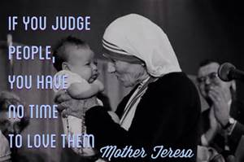
Humanity
Love: Valuing close relations with others, in particular those in which sharing and caring are reciprocated; being close to people
Kindness [generosity, nurturance, care, compassion, altruistic love, "niceness"]: Doing favors and good deeds for others; helping them; taking care of them
Social Intelligence [emotional intelligence, personal intelligence]: Being aware of the motives and feelings of other people and oneself; knowing what to do to fit into different social situations; knowing what makes other people tick

Slide 33
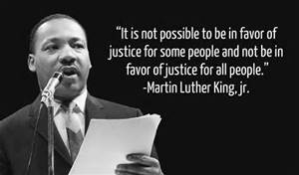
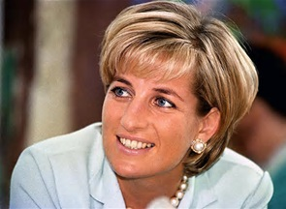
Justice
Teamwork [citizenship, social responsibility, loyalty]: Working well as a member of a group or team; being loyal to the group; doing one's share
Fairness: Treating all people the same according to notions of fairness and justice; not letting personal feelings bias decisions about others; giving everyone a fair chance.
Leadership: Encouraging a group of which one is a member to get things done, and at the same time maintaining good relations within the group; organizing group activities and seeing that they happen.

Slide 34
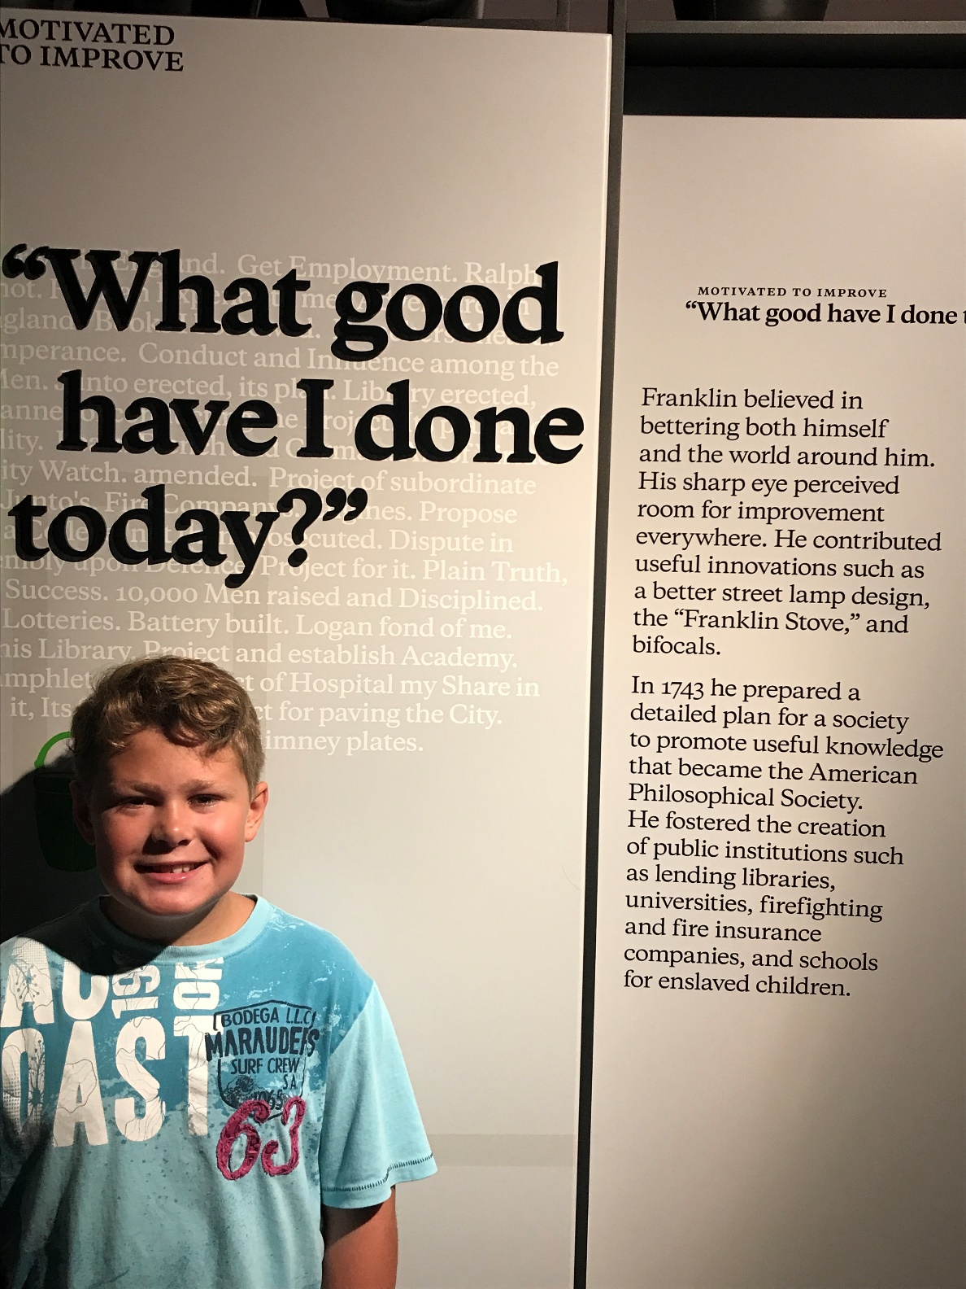

Slide 35
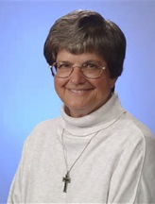
Temperance
Forgiveness: Forgiving those who have done wrong; accepting the shortcomings of others; giving people a second chance; not being vengeful
Humility: Letting one's accomplishments speak for themselves; not regarding oneself as more special than one is
http://www.sisterhelen.org/

Slide 36
Temperance
Prudence: Being careful about one's choices; not taking undue risks; not saying or doing things that might later be regretted
Self-Regulation [self-control]: Regulating what one feels and does; being disciplined; controlling one's appetites and emotions

Slide 37
Transcendence
Transcendence: emotional strengths that reach outside and beyond you to connect you to something larger and more permanent: to other people, the future, evolution, the divine or the universe
Appreciation of Beauty and Excellence [awe, wonder, elevation]: Noticing and appreciating beauty, excellence, and/or skilled performance in various domains of life, from nature to art to mathematics to science to everyday experience
Gratitude: Being aware of and thankful for the good things that happen; taking time to express thanks

Slide 38

Transcendence
Hope [optimism, future-mindedness, future orientation]: Expecting the best in the future and working to achieve it; believing that a good future is something that can be brought about
Humor [playfulness]: Liking to laugh and tease; bringing smiles to other people; seeing the light side; making (not necessarily telling) jokes
Spirituality [faith, purpose]: Having coherent beliefs about the higher purpose and meaning of the universe; knowing where one fits within the larger scheme; having beliefs about the meaning of life that shape conduct and provide comfort

Slide 39
Values in Action Inventory of Strengths (VIA-IS)
Measures 24 character strengths
on-line and paper-and-pencil measure for adults
Psychometrically sound (valid and reliable)
Sensitive to change over time

Slide 40
Values in Action Inventory of Strengths for Youth (VIA-Youth)
Measures 24 character strengths
on-line measure for adolescents
Adequate psychometric properties

Slide 41
The Components of Emotions
Social and Cultural Influences on Emotions
People regulate moods based on understanding of social situations
Examples: Victorian era: highly erotic for women to show legs in public; insults led to deadly duels to protect one’s honor

Slide 42
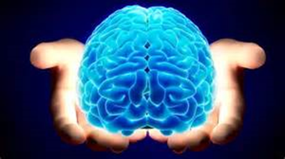
Moods and Well-Being
Question posed by prominent happiness researcher Ed Deiner:
Would you choose to have your brain treated with a chemical hormone that would make you ecstatically happy all of the time?

Slide 44
Moods and Well-Being
Affect:
Immediate, physiological response to a stimulus
Involves appraisal of event as painful or pleasurable
A component of emotion
Emotion
A feeling state resulting from the appraisal of an external object as salient to our own well-being
A specific quality
Always has an object
Mood
Objectless, free floating, and long lasting

Slide 45
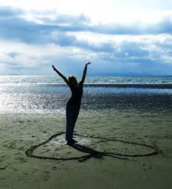
Moods and Well-Being
Emotions and moods not the same, but there’s some disagreement as to how they are different
Moods: more diffuse, global and pervasive than emotions
Emotions: focused feelings that appear or disappear rapidly in response to events in the social environment
Emotions and moods can impact almost any psychological process
Moods--a continuous monitoring system that we can cope with events
Faster thinking, more positive moods

Slide 46
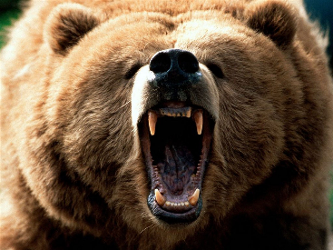
Historical Study of Emotions
More focus on negative emotions
- Negative emotions (e.g., fear, anger) can harm the body but also have survival value (Selye, 1936)
Less focus on positive emotions
- Seen as having hedonic (pleasure-based) value only
Focus has gotten more balanced recently

Slide 47
Historical Study of Emotions
Development of the PANAS by Watson & Clark
Measures both Positive and Negative Affect
Content of Negative Affect: general distress
Content of Positive Affect: joviality, self-assurance, and attentiveness
Positive and Negative Affect viewed as independent (not polar opposites)
Notes:
Make page correction here

Slide 48
PANAS 1 (very slightly 2 (A little) 3 (Moderately) 4 (Quite a bit) 5 (extremely) or not at all)
____ interested
____ distressed
____ excited
____ upset
____ strong
____ guilty
____ scared
____ hostile
____ enthusiastic
____ proud
____ irritable
____ alert
____ ashamed
____ inspired
____ nervous
____ determined
____ attentive
____ jittery
____ active
____ afraid

Slide 49
Positive Affect
Some people have a lot of positive affect
Feel great much of the time
Good things bring them pleasure and joy in abundance
Some people have little positive affect
Don’t feel great
Don’t jump for joy at success
Seligman has a friend, Len, who is low in positive affect. But he is happy. So, people can be happy even if they don’t have much positive emotion

Slide 50
Positive Psychology and Motivation
Early theories of motivation
Motivation and emotions are intertwined--difficult to separate individual effects
People can be motivated by more than just drives to fulfill physiological needs

Slide 51
Positive Psychology and Motivation
Intrinsic and Extrinsic Motivation
Intrinsic motivation--autonomous
Engagement in an activity regardless of an external reward
Autonomous--self-chosen and congruent with one’s true self

Slide 52
Positive Psychology and Motivation
Intrinsic and Extrinsic Motivation
Extrinsic motivation
Engagement in an activity to gain an external reward
Controlled--driven by external rewards or guilt

Slide 53
Positive Psychology and Motivation
Intrinsic and Extrinsic Motivation Results
High autonomously motivated positively related to:
Achieving positive outcomes in health, work, romantic relationships, parenting, education, religious participation, and political activism
Enhanced performance, persistence, creativity, self-esteem, vitality and general well-being

Slide 54
Positive Psychology and Motivation
Motivation and the Pursuit of Goals
Approach goals motivate us to move toward something
Avoidance goals motivate us to avoid difficulties, dangers, or fears

Slide 55
Positive Psychology and Motivation
Motivation and the Pursuit of Goals Research
Goals that are the result of autonomous motivation, personally valued, realistic, and freely chosen better at raising subjective well-being
Pursuing meaningful goals more fulfilling
Self-concordance (personality-goal fit): better fit between values and goals, more positive evaluation of goal, greater motivation, greater commitment to the goal, higher well-being

Slide 56
Positive Psychology and Motivation
Motivation and the Pursuit of Goals Research
Well-being enhanced by seeking goals associated with positive relationships with others
Pursuing goals admired in one’s culture can lead to greater social rewards
Approach goals more likely to be related to subjective well-being

Slide 57

Positive Psychology and Motivation
Motivation and the Pursuit of Goals
Four strategies to foster goal attainment:
Own your goal
Make it fun
Remember the big picture
Keep a balance between abstract and concrete goals
Notes:
Own your goal: Reinforce personal reasons for pursuing the goal.
Make it fun: Enhance intrinsic motivation.
Remember the big picture: Remember how small goals fit into long-term goals.
Keep a balance: Between goals and other aspects of life.

Slide 58
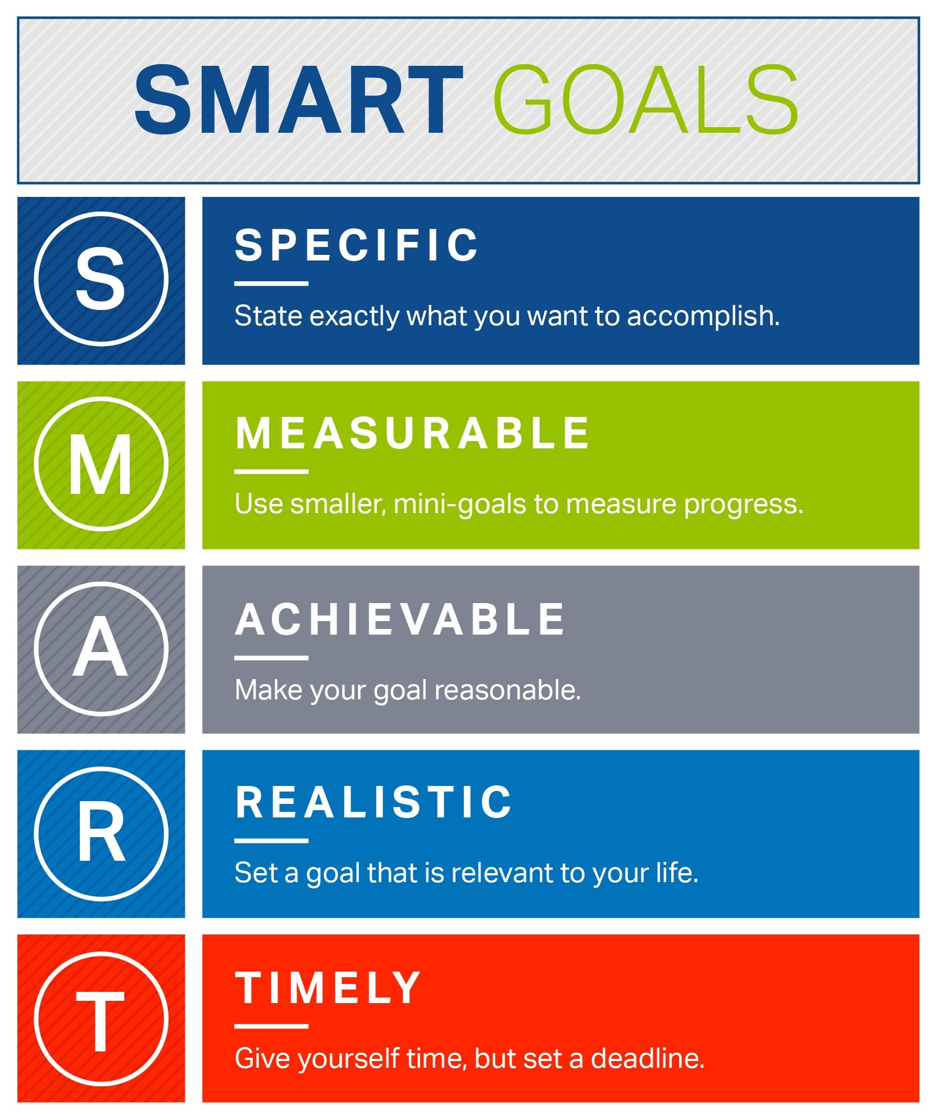

Slide 59
Positive Psychology and Motivation
Motivation and the Pursuit of Goals: Striving and Well-Being
Personal Striving (groupings of smaller goals)
Extrinsic strivings (for reward or for someone else)
Introjected strivings (to avoid guilt)
Identified strivings (goal someone else says is important)
Intrinsic strivings (personally meaningful)
Notes:
Personal strivings: Groupings of smaller goals that may help to facilitate larger, more abstract goals.
Extrinsic strivings: Done for the sake of someone else or only for extrinsic rewards.
Introjected strivings: Pursued not necessarily for personally relevant reasons but because if you didn’t, then you’d feel guilty or that you’d let someone down.
Identified strivings: Relate to pursuing a goal that someone else says is important.
Intrinsic strivings: Engaged in because they are personally meaningful and have been freely chosen by the individual.

Slide 60
Positive Psychology and Motivation
Motivation and the Pursuit of Goals: Hope Theory
Hope theory is a result of two processes
Pathways (believing one can find ways to achieve goal)
Agency (believing one can become motivated enough to pursue those goals
Hope for the future is the result of believing we can create both realistic plans and enough drive to reach important goals
People who are hopeful also tend to feel more positive emotions
Notes:
Pathways: Believing that one can find ways to reach desired goals.
Agency: Believing that one can become motivated enough to pursue those goals.

Slide 61
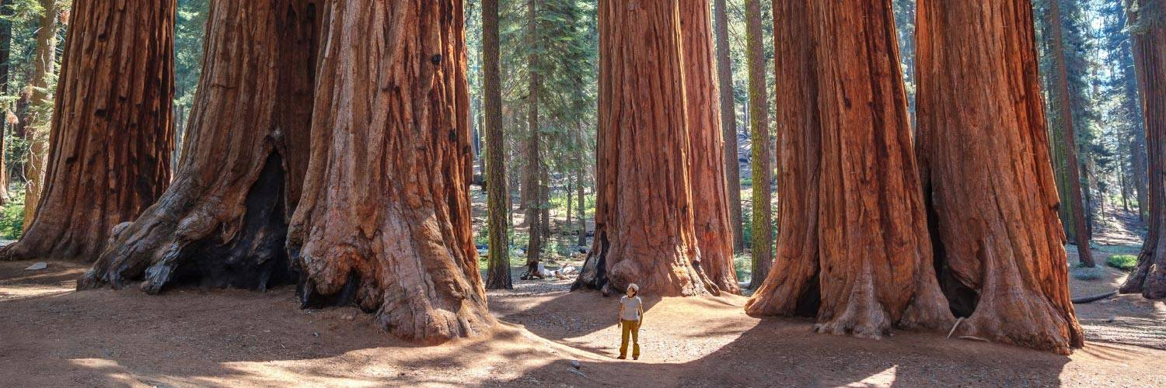
Positive Psychology and Motivation
Motivation and the Pursuit of Goals: Affective Forecasting
Predicting how one will feel upon achieving goals
People not very good at affective forecasting
Asking others about what they felt after achieving goals a more accurate assessment
So, enjoy the journey to goal attainment!

Slide 62
Well-Being and Positive Emotion
Fewer basic positive emotions: Ratio of 1positive to every 3–4 negative emotions
Direct linkage between emotion and action absent in positive emotions
e.g., fight or flight when negative emotion fear
Positive emotions make us feel good after all of the dangers have been taken care of

Slide 63
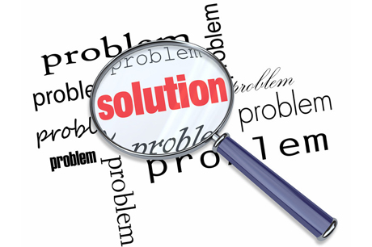
The Study of Positive Emotions
Alice Isen, Cornell University
When experiencing mild positive emotions, people are more likely to:
- help others
- be flexible in their thinking
- better problem-solve
- more willing to exhibit self-control

Slide 64
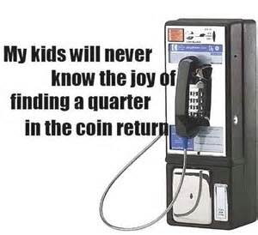
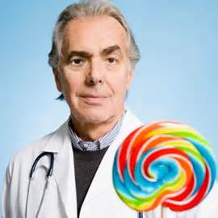
The Study of Positive Emotions
Examples of research:
Coins in pay phones…help others (Isen, 1970)
Candies & physicians (Estrada, Isen, & Young, 1997)
Superior reasoning and decision making

Slide 65
Well-Being and Positive Emotion
The Broaden and Build Model
Positive emotions broaden intellectual, physical and social resources
When in a positive mood, people like us better, and friendship, love, and coalitions are more likely to be established
And, our mental set is expansive, tolerant, and creative; open to new ideas and new experience

Slide 66
Well-Being and Positive Emotion
The Broaden and Build Model
Positive emotions give us
nonspecific action tendencies that lead to new adaptive behavior
the spark for changes in cognitive activity that lead to newer thought-action tendencies
broadening of our available options to maximize our future resources
Notes:
.

Slide 67
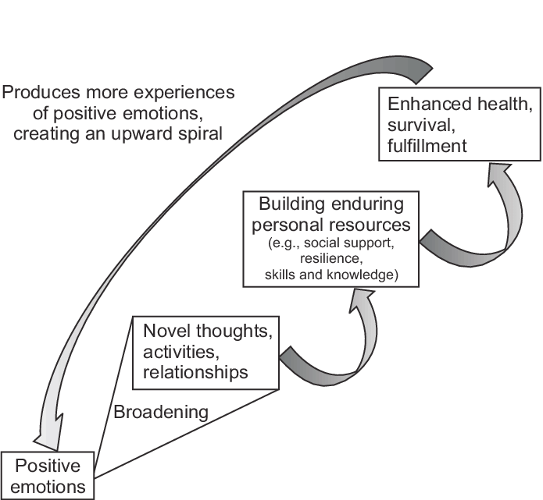

Slide 68
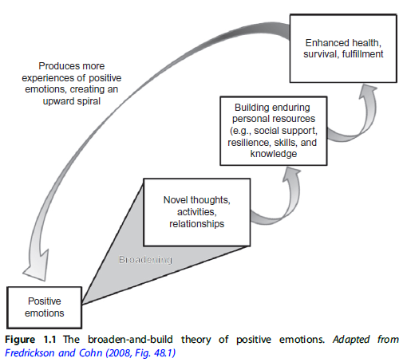
Fredrickson’s Broaden and Build Theory
Positive Emotions
Reduce arousal
Broaden visual focus, thoughts and behavior
Broadening
Thinking becomes more creative, inclusive, flexible, and integrative
By broadening attention and action, positive emotions can contribute to our creativity, physical health, relationships, and ability to acquire new information, as well as our psychological resilience

Slide 69

Positive Emotion and Creativity
Candleholder experiment with a twist
Before experiment, made
to feel a positive emotion
Positive emotion induced
makes you more likely to
be creative in completing
task.

Slide 70
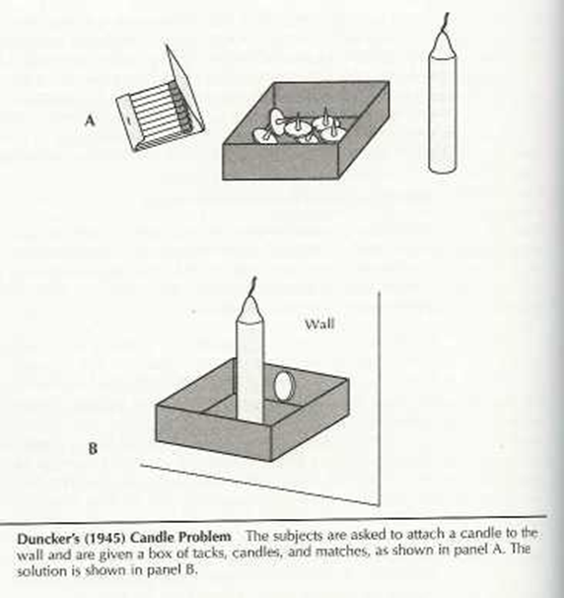

Slide 71
Well-Being and Positive Emotion
The Broaden and Build Model:
Positive Emotions as Antidotes to Stress
Undoing hypothesis: positive emotions help both the body and the mind regain a sense of balance, flexibility, and equilibrium after the impact of negative emotions
e.g., laughing at self after mistake relieves tension and stress hormones
Positive emotions help shorten the aftereffects of stress reactions in a shorter period of time
Broaden attention and build resources
Note: Incorporating self-efficacy increases model’s predictions
Notes:
Broaden attention and build resources: But only for resources associated with social interactions and social behavior.

Slide 72
Well-Being and Positive Emotion
The Broaden and Build Model: A Critical Positivity Ratio
Flourished life--mean ratio of positive to negative emotions at or above 2.9
Some positivity ratio should still be predictive of greater flourishing

Slide 73
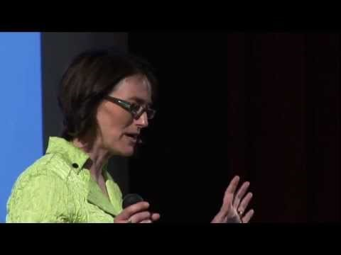
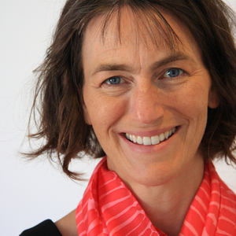
Barbara Fredrickson
The Science of a Meaningful Life

Slide 74
Well-Being and Positive Emotion
Emotional Intelligence
An ability to recognize the meanings of emotions and their relationship, and to reason and problem solve on the basis of them
Notes:
Have it as a personality trait: Specifically, a trait related to a person’s self-perceived competencies at understanding emotions.

Slide 75
Well-Being and Positive Emotion
Emotional Intelligence
People with high EI
are able to use emotions wisely
have a deeper understanding of their emotional lives
have it as a personality trait
Notes:
Have it as a personality trait: Specifically, a trait related to a person’s self-perceived competencies at understanding emotions.

Slide 76
Well-Being and Positive Emotion
Emotional Intelligence: The Dimensions of Emotional Intelligence
People with higher EI at work tend to contribute to a positive workplace environment
Higher EI leads to both higher merit pay and higher rank
EI could be increased with a 4-week training program

Slide 77
Research Models of Happiness and Well-Being
Engine model of well-being involves inputs, processes, and outcomes
Enormous variety of behaviors that people use to enhance their well-being
The ways people pursue positive emotion and flourishing into two perspectives called the hedonic and eudaimonia
Notes:
Engine model of well-being involves inputs, processes, and outcomes:
Inputs: Inputs are variables that are preexisting or endogenous to the person.
Process: Refers to internal states that influence the choices people make that influence their well-being.
Outcome: Refers to voluntary behavior that people choose in their search for well-being.

Slide 78
Research Models of Happiness and Well-Being
Hedonic Perspectives
Goal--to increase happiness in a variety of ways
Focus--on finding and fostering positive emotionality

Slide 79
Research Models of Happiness and Well-Being
Eudaimonic Perspectives
Associated with fulfilling one’s true nature and finding one’s true self
Difficulties--encompasses a relatively broad collection of approaches to well-being

Slide 80
Research Models of Happiness and Well-Being
Engagement Perspectives
Views well-being as a function of how absorbed we are in the activities of life
Process of being fully involved in an active life that really matters

Slide 81
Research Models of Happiness and Well-Being
Multidimensional Models of Well-Being: Self-Determination Theory (SDT)
Basic needs in SDT
Competence
Relatedness
Autonomy
A new sub-theory within SDT is called organismic-integration theory
Notes:
Competence: The need for mastery experiences that allow a person to deal effectively with her or his environment.
Relatedness: The need for mutually supportive interpersonal relationships.
Autonomy: The need to make independent decisions about areas in life that are important to the person.

Slide 82
Research Models of Happiness and Well-Being
Multidimensional Models of Well-Being: Authentic Happiness and Well-Being Theory
It involves the cultivation of three broad life domains:
The pleasant life
The good life
Engagement, and the meaningful life
Authentic happiness, Seligman asserted that authentic happiness was based on positive mood
PERMA!!!!
Notes:
The pleasant life: Focused on positive emotions.
The good life: Found primarily through engagement in activities that are absorbing and promote full participation in life.
The meaningful life: Involves using signature strengths in the service of something that is larger and more significant than the individual self.

Slide 83
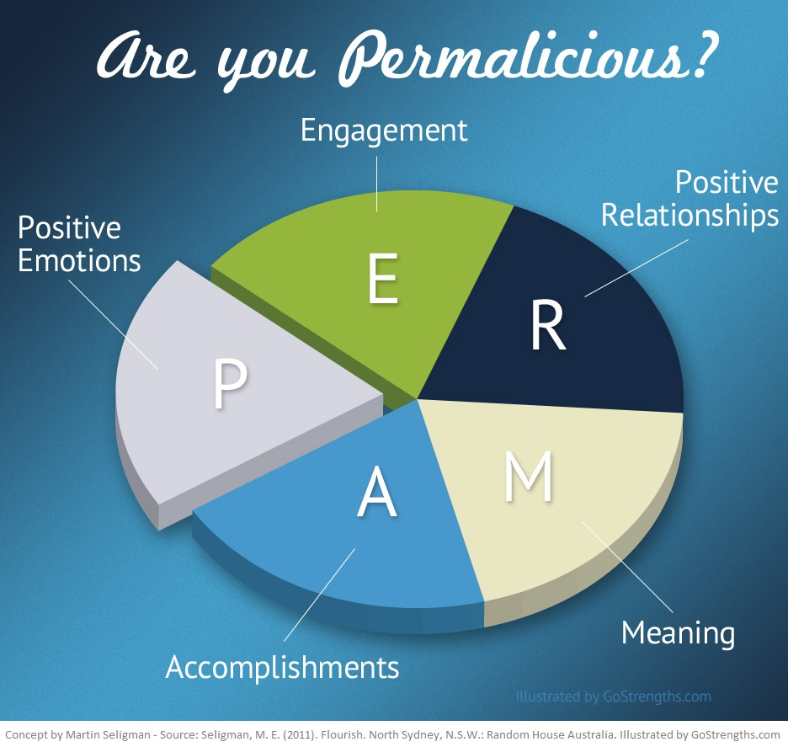

Slide 84
Research Models of Happiness and Well-Being
Multidimensional Models of Well-Being: Psychological Well-Being
Self-acceptance
Personal growth
Positive relations with other people
Autonomy
Purpose in life
Environmental mastery

